Slide 1
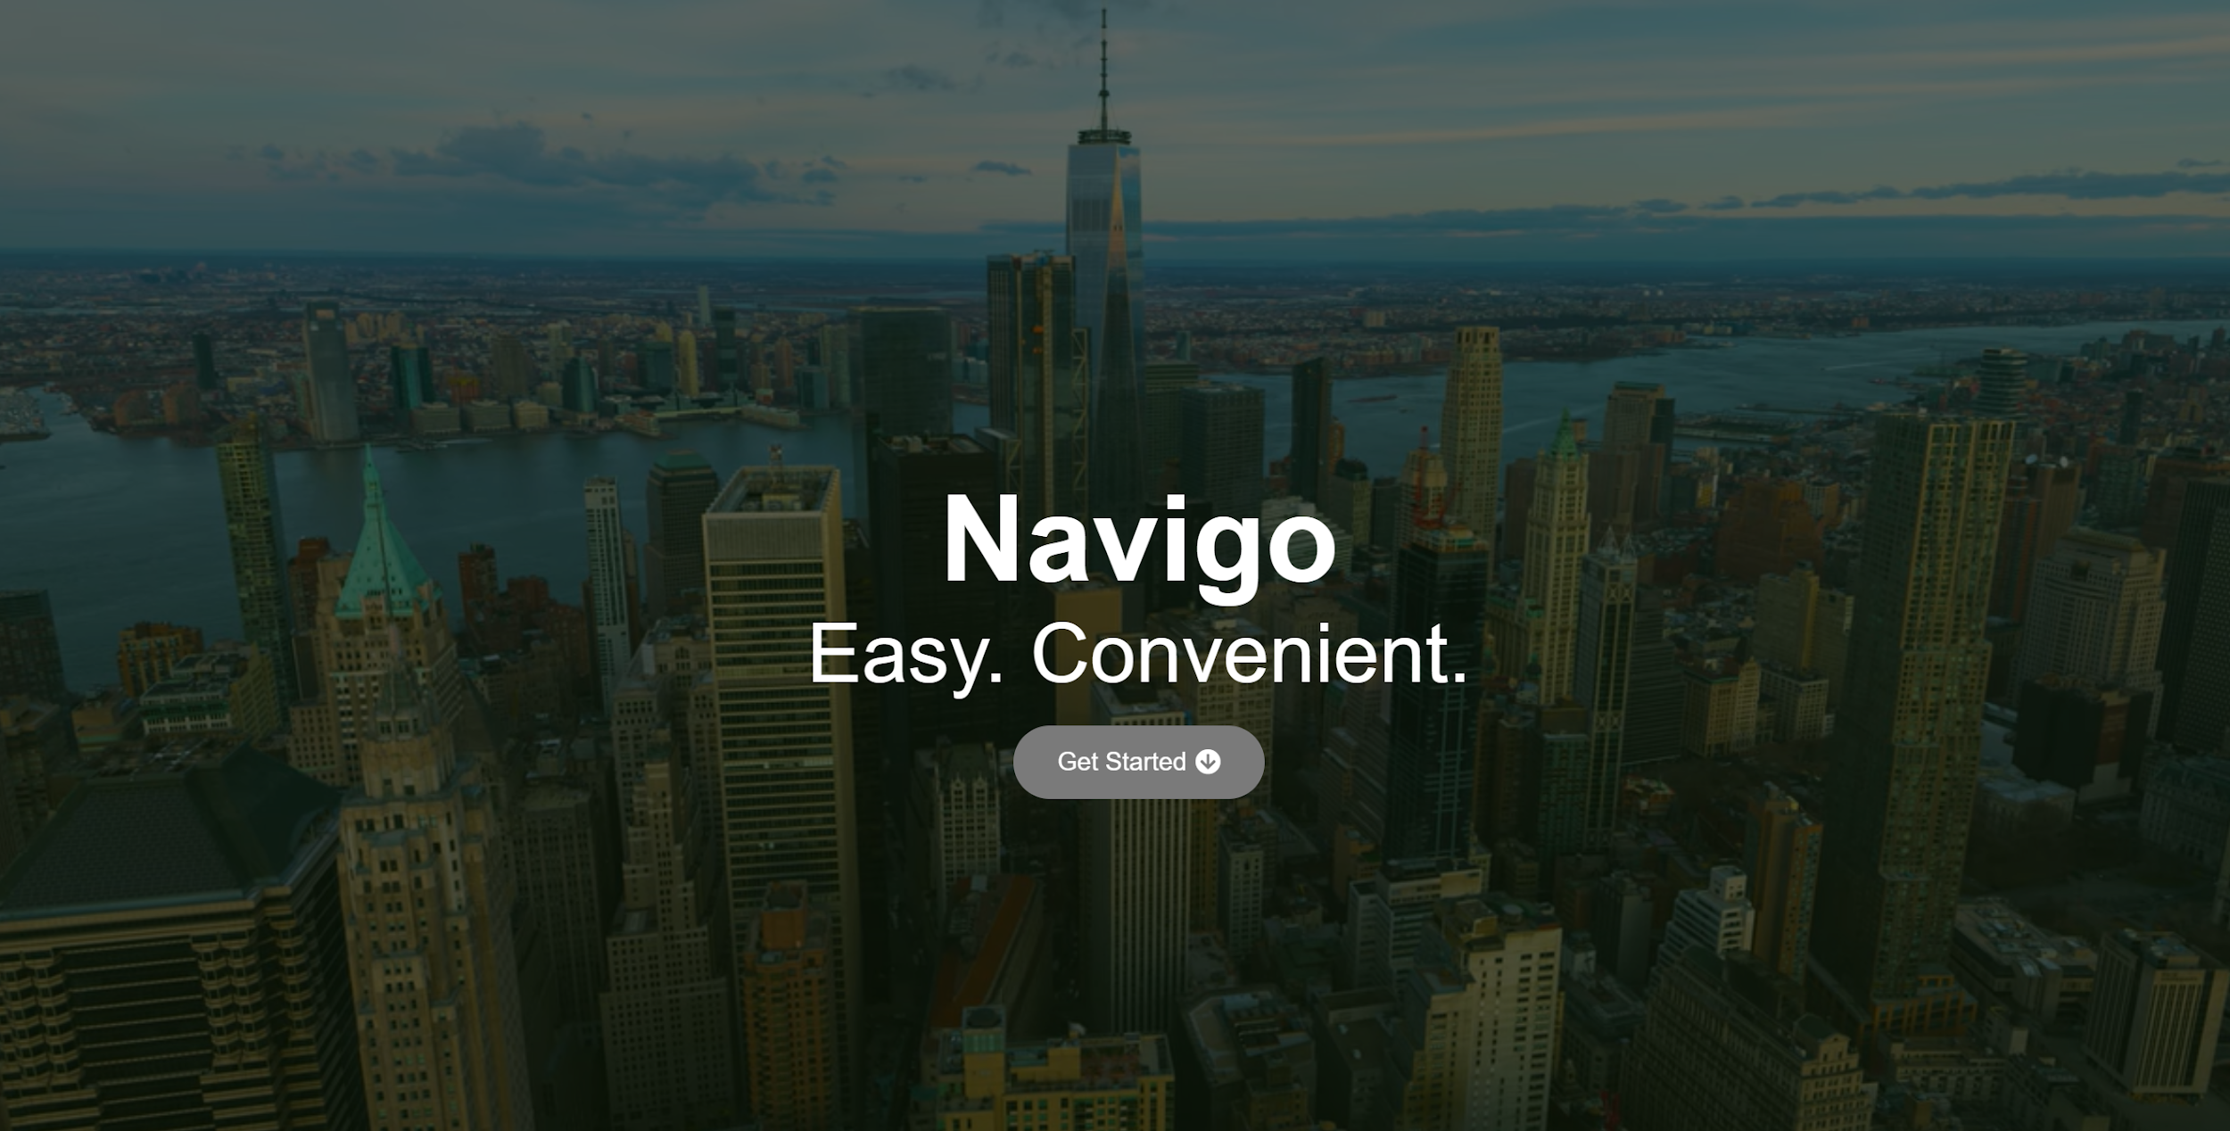

Group 1:
- Priya (is13658n@pace.edu)
- Kartik (kk96691n@pace.edu)
- Sunil (sm12210n@pace.edu)
- Pranav (pk73658n@pace.edu)
- Bharath (sv90693n@pace.edu)
- Rahul (rs15193n@pace.edu)
Sprint 4 Deliverable :
CS 691 - Computer Science Project 1
Prof. Henry Wong

Slide 2

Introduction to Navigo
Navigo is a navigation based web application which helps the end users in navigation based on the user’s image input.
In order to use our Navigo services, the end user must be a subscriber (registered) user. The user can first get started by creating an account in our website.
The user also receives details/information such as address details, travel duration, office hours, redirecting to website, etc.
The user can register for Navigo’s services by signing up/creating a new account in our website. The user then logs in with his ID/password credentials and start using our service. The registered user can input an image for scanning for navigation.

Slide 3
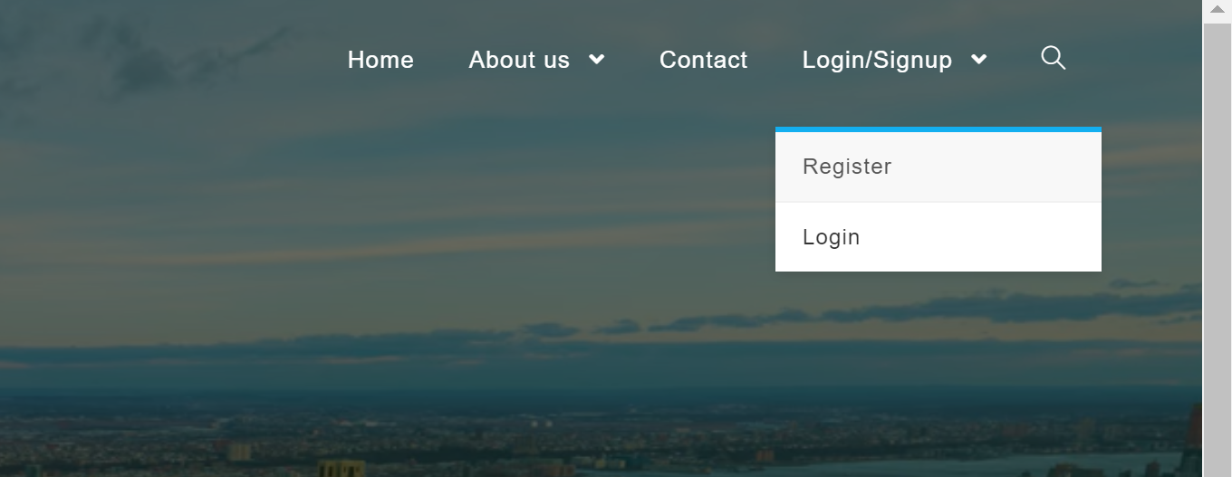
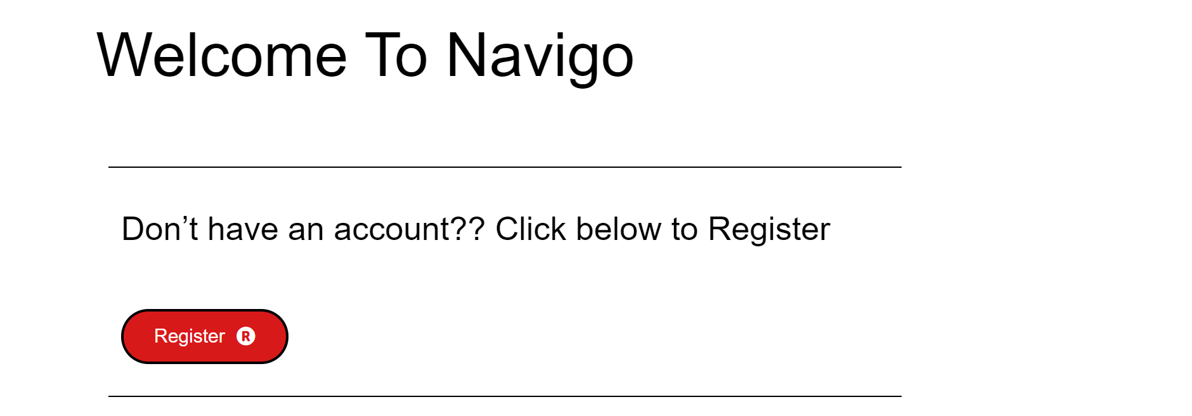
User Stories
Registration User Story (Sign up):
Scenario 1: Unregistered User should see a link to user signup:
Given an unregistered user. When the user enters our website, a link to sign up as a user should be available for the user. Using either the “Get started icon” or “Register” from Login/Sign up drop down menu, the user can access the link for sign up.
Scenario 2: Unregistered User should see a registration form:
Given an unregistered user. When the user clicks on” Don’t have an account?? Click below to Register”, then the user should see a form allowing the user to sign up for our website. By clicking the register button below the “ Don’t have an account?? Click below to Register” prompt, the user can see the registration form.

Slide 4
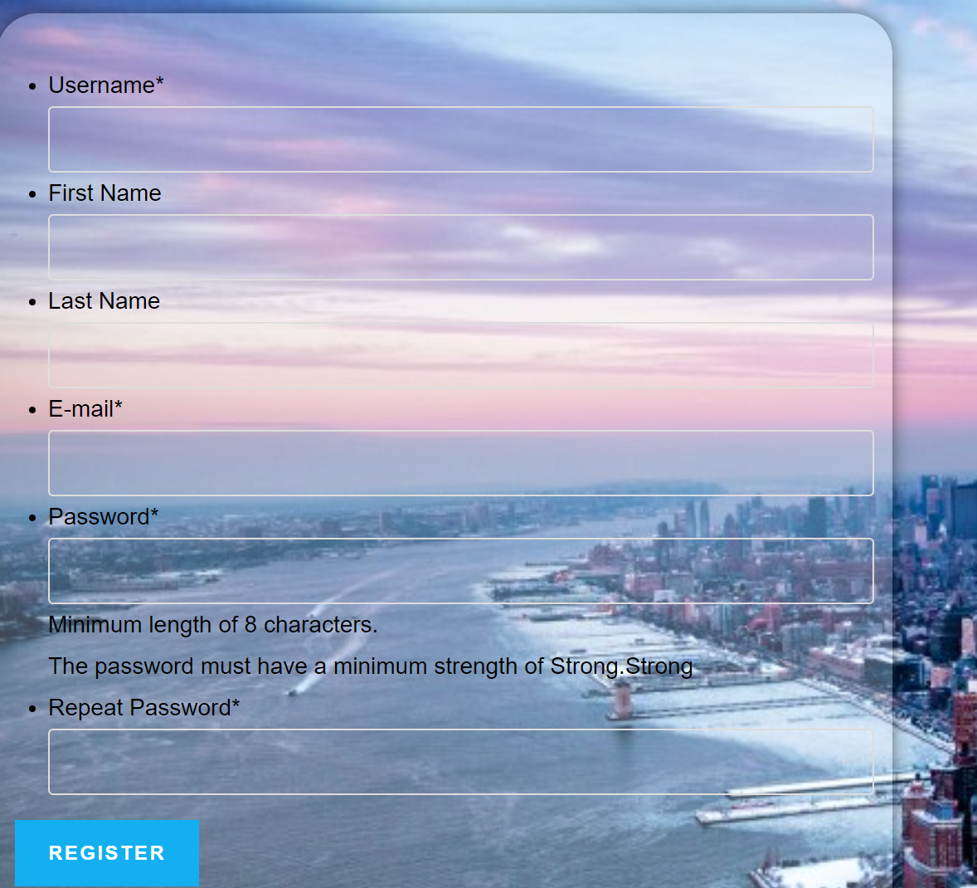
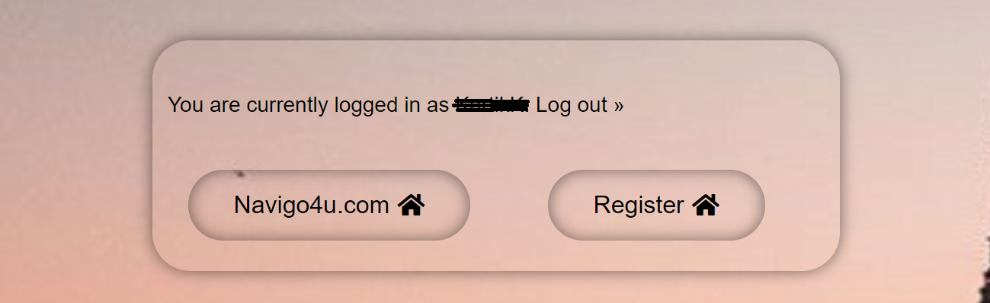
User Stories
Scenario 3: Unregistered User should receive confirmation email on signup:
Given an unregistered user. When the user fills out the sign up form and clicks submit, then the user should receive a confirmation email with a link from Navigo that activates the user’s account. The following fields are to filled up by the user, in the registration form.
Username
First Name
Last Name,
E-Mail
Password (Strong Password with a minimum of 8 characters)
Scenario 4: Unregistered User should be able to activate user account:
Given an unregistered user. When the user receives and activates the account confirmation link, the user should be able to have his account activated (registered account), through which he can use our services.

Slide 5
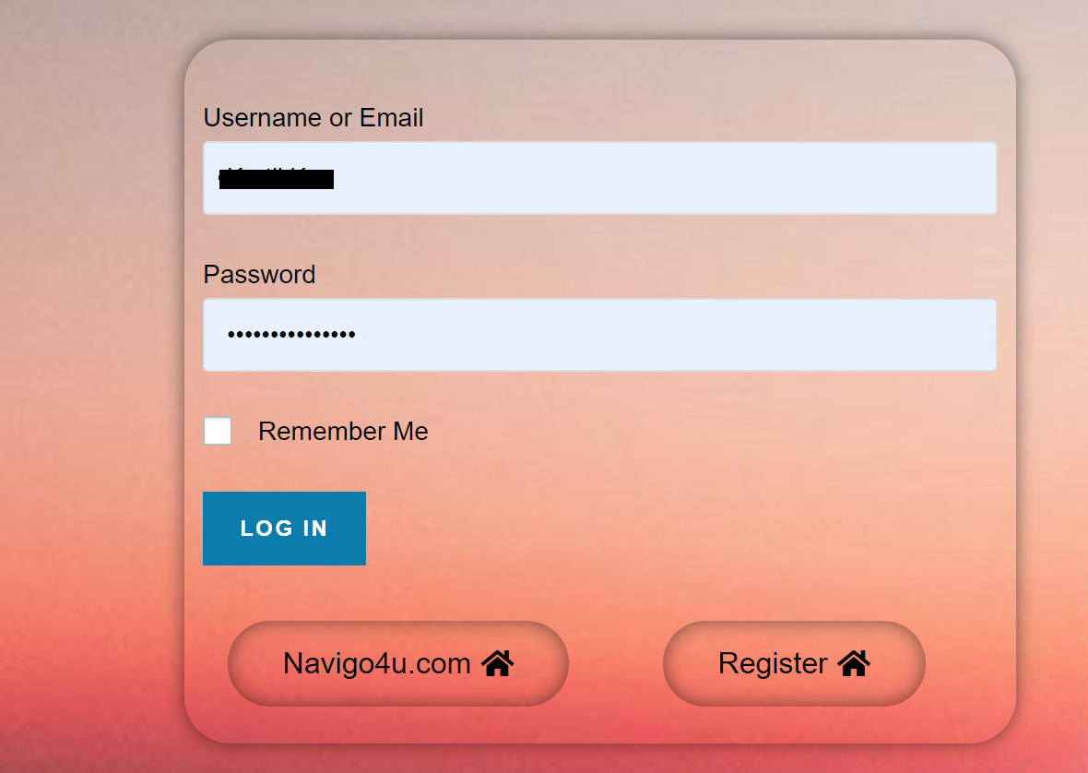
User Stories
Login Page User Story:
Scenario 1: Registered User should be able to enter the login credentials on the login form:
Given a Registered user. When the user enters our (Navigo) website, The user should see login screen with input data fields for
1) Username
2) Password
Scenario 2: Registered User should be able to successfully login with his correct credentials.
Given a Registered user. When the user, User should be able to successfully login using his correct username and password. He should also see a screen that displays “you are currently logged in as xyz”.

Slide 6
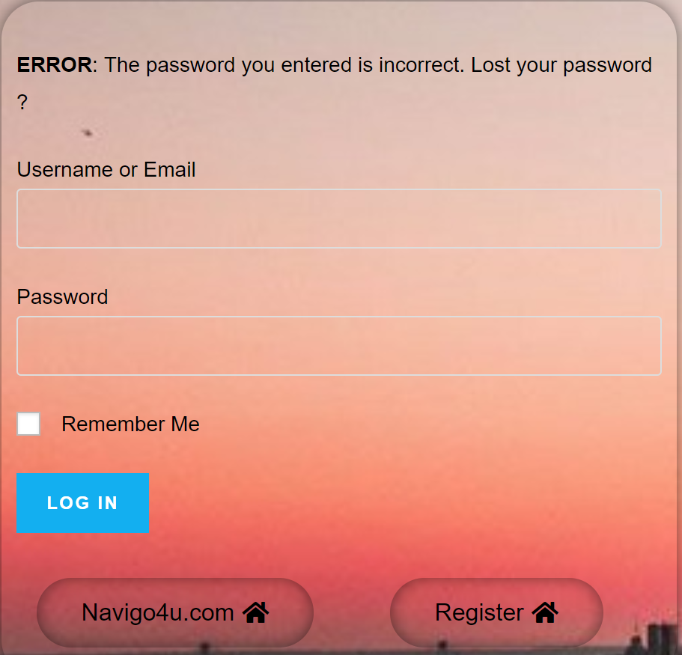
User Stories
Scenario 3: Registered User should get a prompt if the user enters incorrect credentials.
Given a Registered user: When a user enters incorrect login credentials (username, password or both), our Navigo website should display a message the following message to the user, “The password you entered is incorrect. Lost your password?”. The user is notified about an unsuccessful login with this.

Slide 7
Acceptance Criteria
From the homepage, the user should be able to access the login page via a sign in link.
On the site when the user clicks the 'sign-in’ link, the user is redirected to the login page where the user can enter the email and password for authentication.
Upon successful login, the user is redirected to the successful login page.
Upon successful login, the user’s Username is displayed and displays a “You are currently logged in as, xyz” message.
If the user enters an incorrect username and or password, the user should see an appropriate error message indicating that the user’s credentials are incorrect.
The user should be able to retry authenticating.
The user’s password needs to follow the Navigo’s strong password policy for secure passwords.
The user should also see a link which allows me to register if the user is a new user.

Slide 8
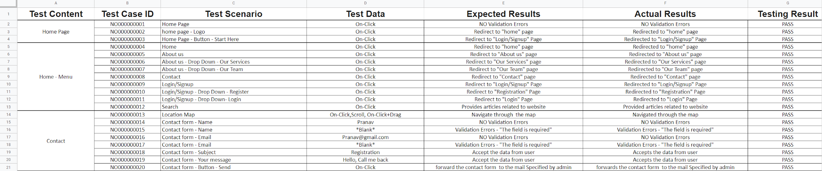
Test Cases

Slide 9
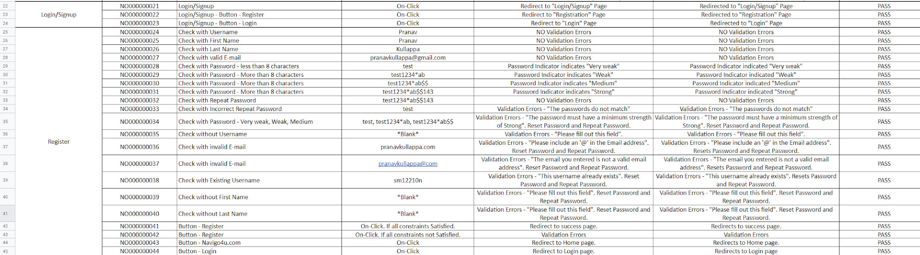
Test Cases

Slide 10
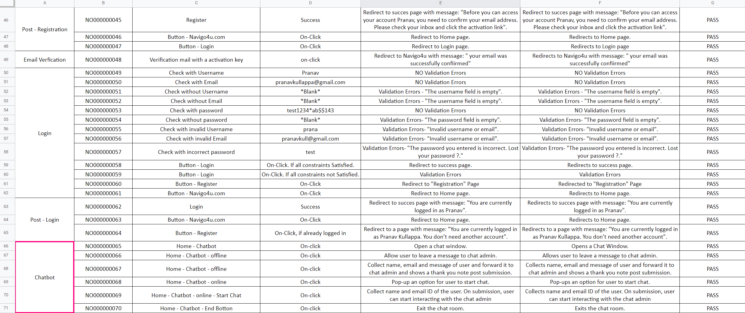
Test Cases

Slide 11

Persona
Many new york yankees fan come to watch baseball to USA from different parts of the world, each of them having different native languages. Matt is 15 years old student also yankee’s fan, who wants to reach a stadium and have no idea about the stadium location. He logged in Navigo application, and searched the stadium name in which address, map, travel duration, new york yankees schedule, ticket cost, etc were provided. Navigo made life easier.

Slide 12

Persona:
An Indian lady in her 50’s came to New York to visit her son, she is not much familiar with locations. Her son has to go to office everyday so if she wants to visit all the tourist attractions on her own, thus when she uses navigo application, she just needs to register and login in Navigo application, in which she has to speak the names of the places to visit and the Navigo application will provide with all the relevant information about the place. Instead of using multiple websites and app she just has to use one application, so it becomes easier for her.

Slide 13
Minimum Viable Product
A minimum viable product (MVP) is a development technique in which a new product or website is developed as an early build of the final product.
Our website for Navigo which can be used primarily for registration/login.
The user can register for Navigo’s services by signing up/creating a new account on our website.
End-user (unregistered) can use our sign-up form to create an account. After filling the sign up form (Unique Username, First Name, Last Name, E-Mail, Password) the user needs to then confirm the account after receiving the confirmation mail from Navigo.
The Website also has an ‘About Us’ page which displays the information regarding our services and our team.
It also includes a contact page through which a user can contact the Navigo Team for any queries or questions regarding our application.
We implemented chatbot which is an automated system of communication with users.

Slide 14
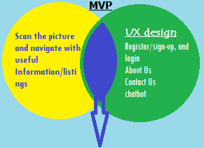
Minimum Viable Product- Minimum Awesome Product
DO
Scan the picture and navigate with useful
Information/listings
PLAN
Clone the Google API with required
information in mobile application
DELEGATE
Consider third-party permitted applications.
ELIMINATE
Remove multiple web pages and make it
user friendly.
Service+ ux = Business

Slide 15
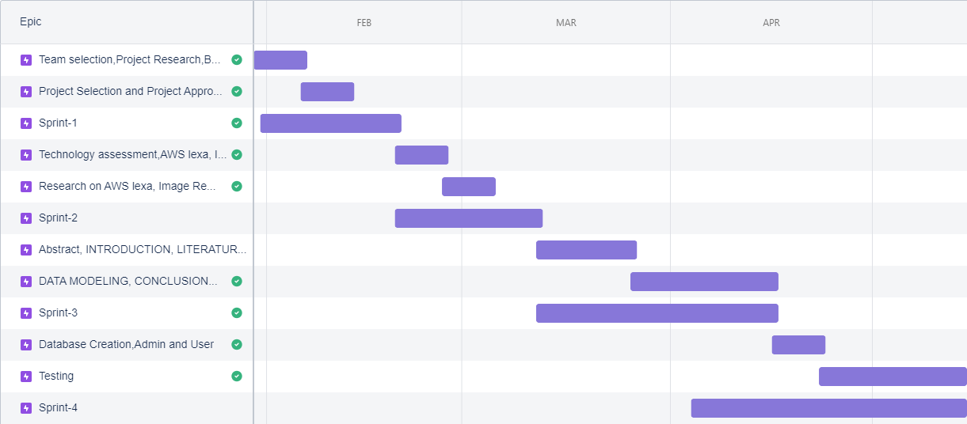
Sprint map

Slide 16
Sprint Log
Task | Status | Priority | Working Hours
Product backlog/ Documentation update | Done | High | 5.5
Wiki page: Code, Technology tools and Project Management | Done | Medium | 5
Wiki page: Architecture and Design, Burndown Charts, Demo | Done | Medium | 2
coding - Home Page, About Us, Contact and Chatbot | Done | High | 12
coding - User Signup and Login | Done | High | 12.5
Manual Testing | Done | High | 1
Draft document on design and technologies | Done | High | 5
Sprint 4 documentation | Done | Medium | 6
Retrospective documentation/MVP | Done | Medium | 2

Slide 17
Product Backlog
Offline Searching
Collecting listings data
Geolocation is a must
Google Maps SDK for iOS and Android
Google Places API
Bookmark locations
Voice-guided directions
Traffic Data (wherever available)
Alternate routes
Speed limit display
Redirecting location name to individual website to clone with particular place visiting time, schedule, ticket cost/coupons/discounts, search engine recommendations near to that place

Slide 18
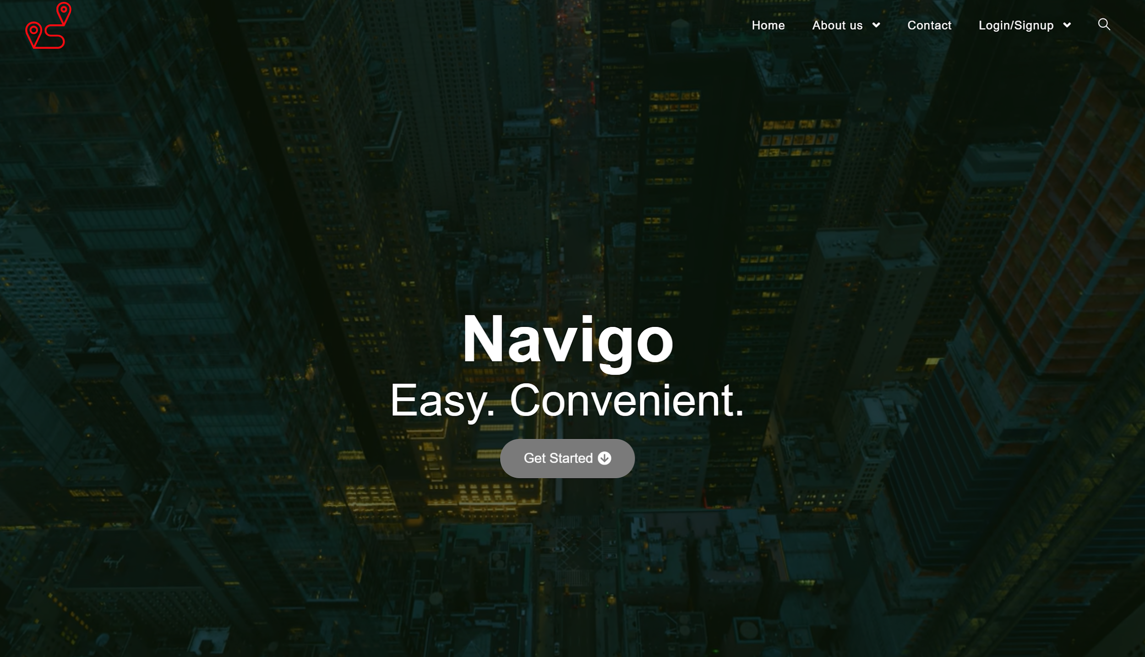
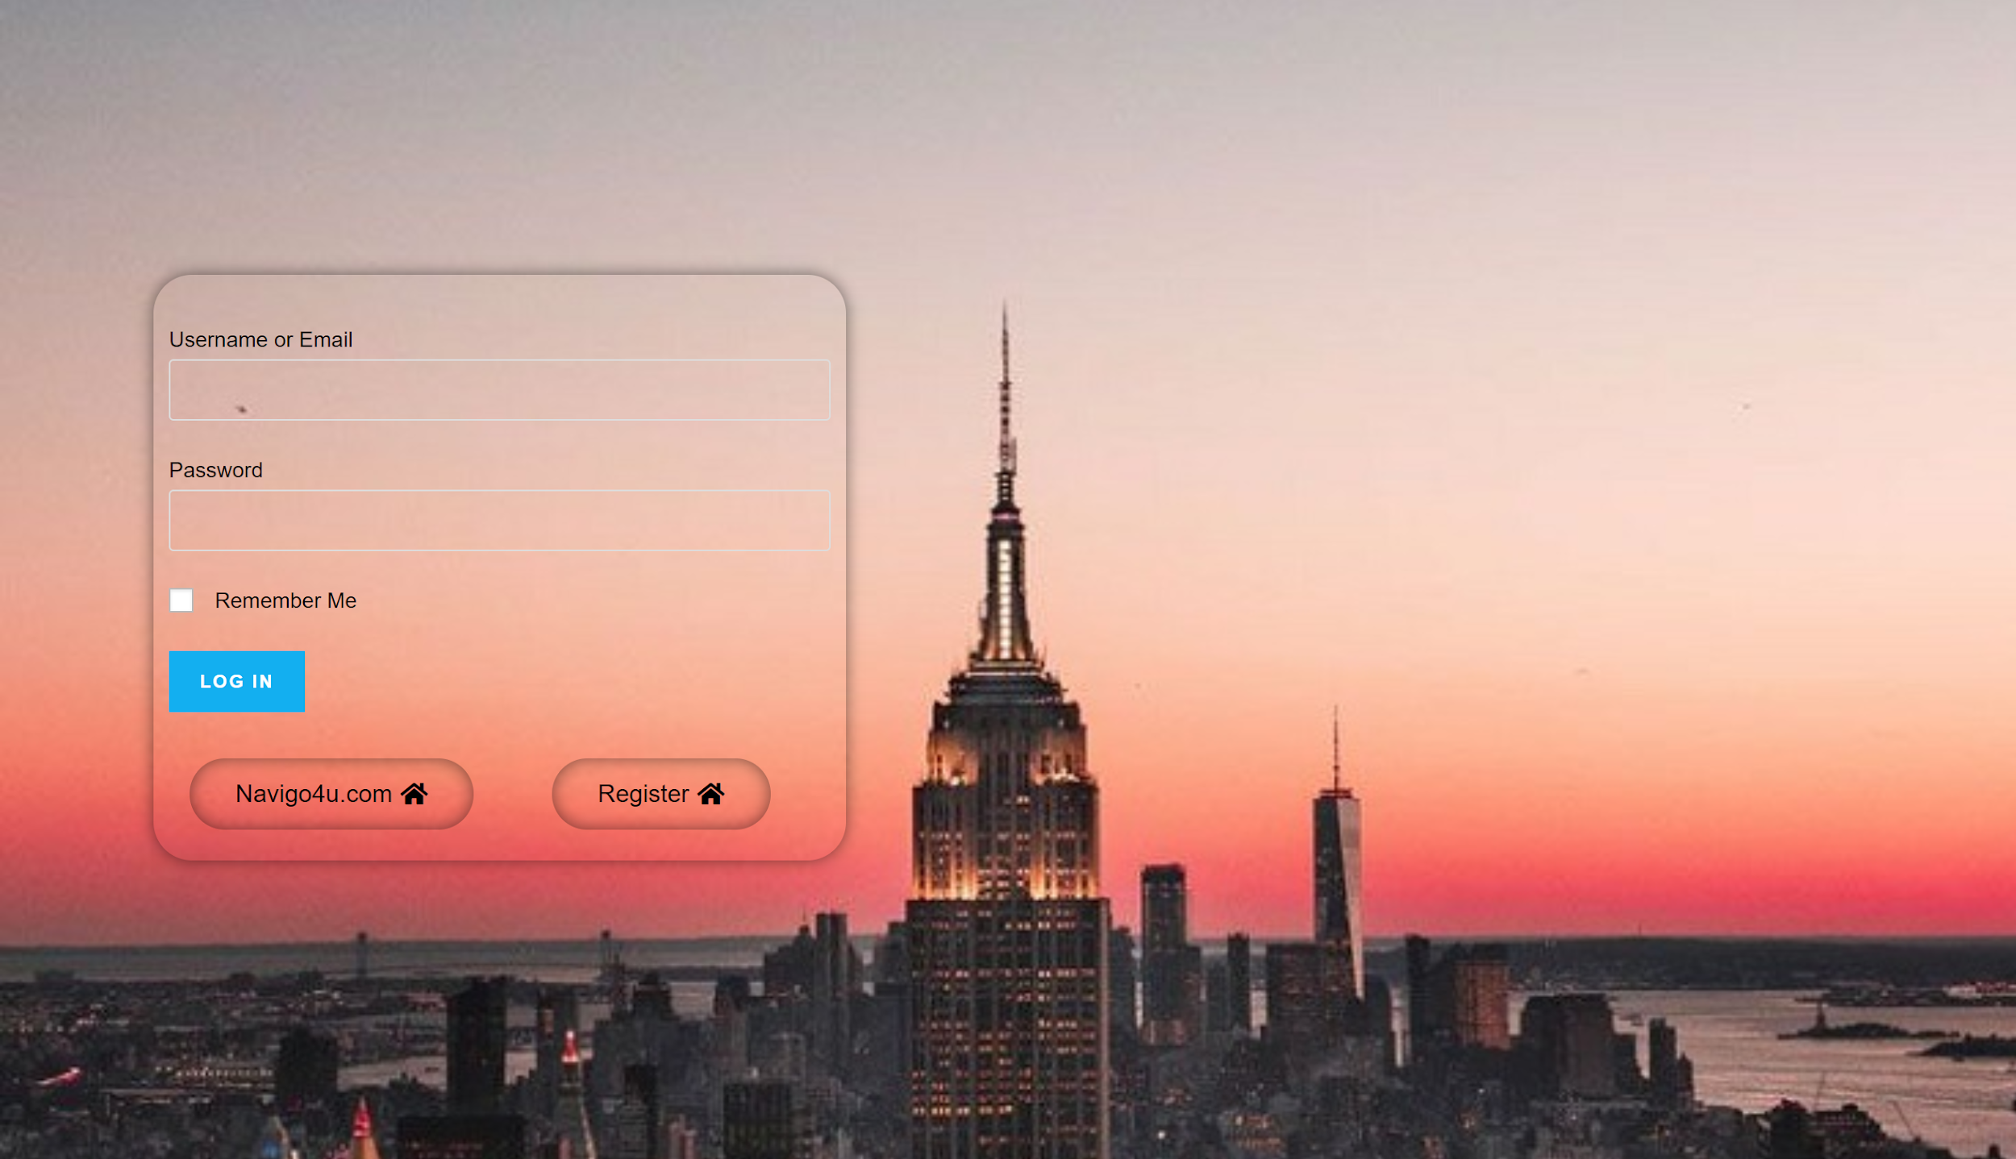
Navigo Preview
Landing/home page
Signup

Slide 19
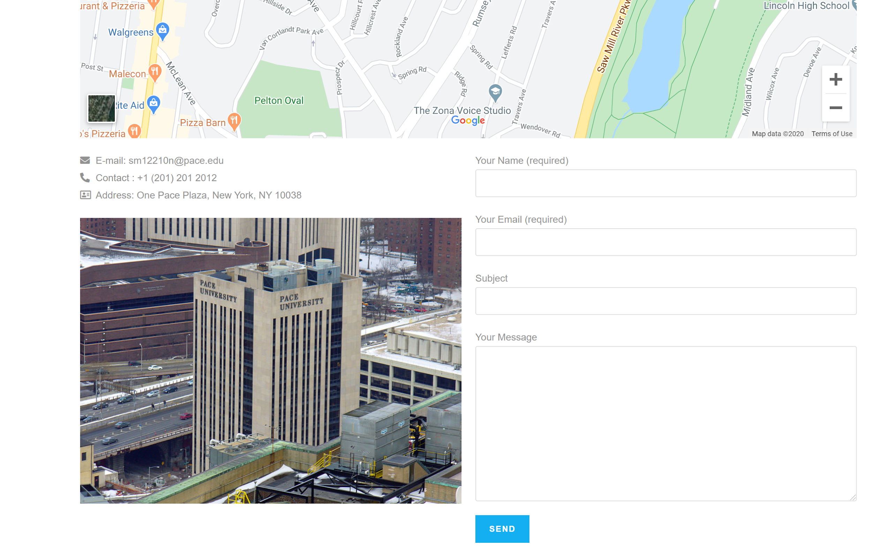
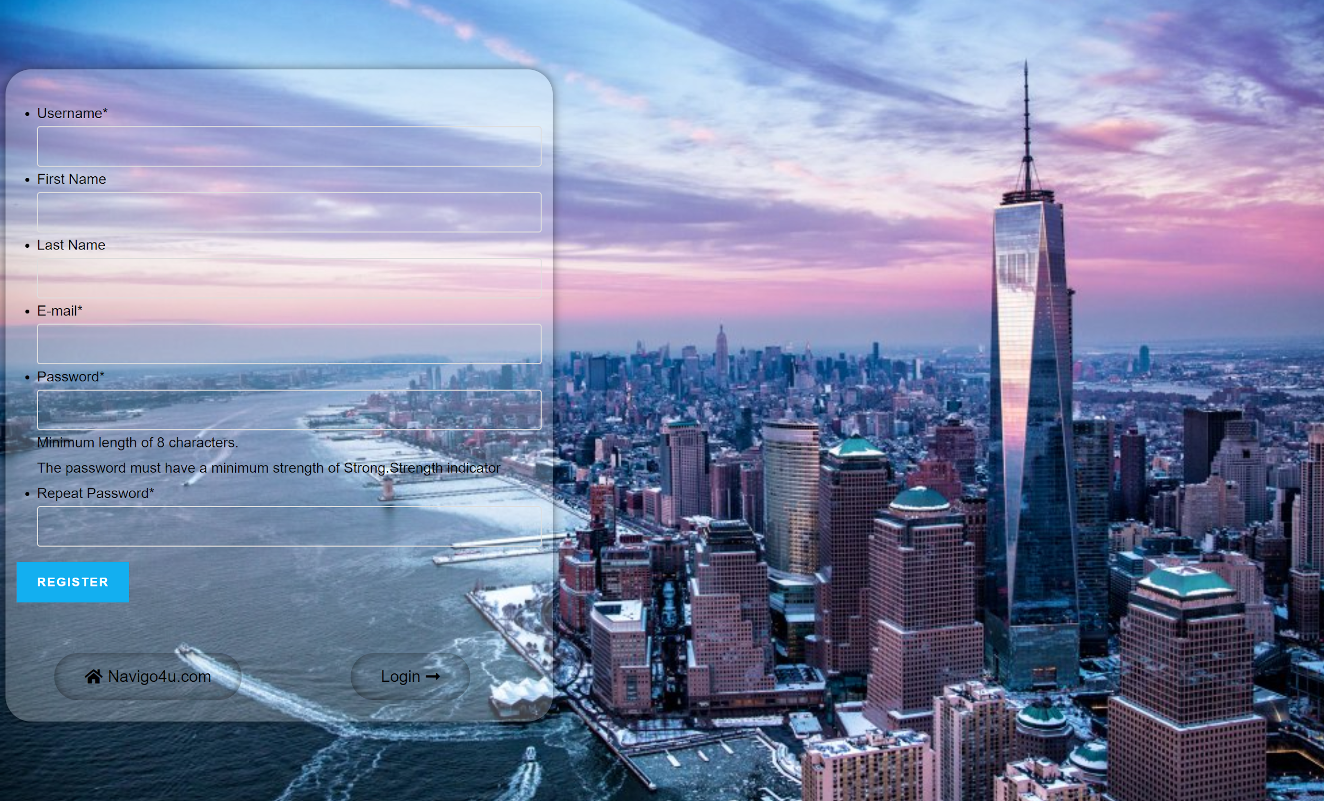
Navigo Preview
Contact us
Register and login

Slide 20

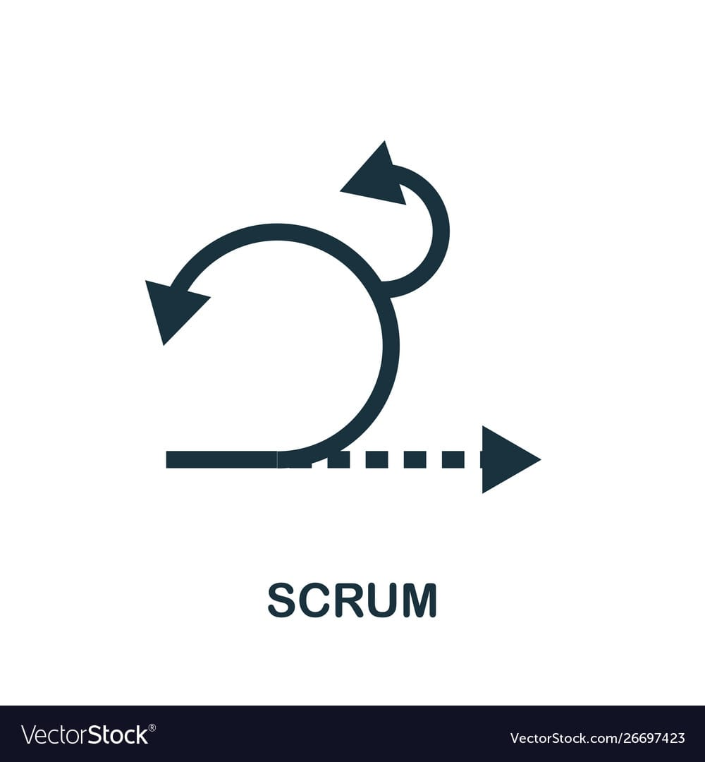











Technologies

Slide 21
Github
Wiki - https://github.com/CS691-001/Project-1/wiki
Repositories - https://github.com/CS691-001/Project-1

Slide 22
Thank you

